Slide 1

COLLEGE OF ENGINEERING
Distributed File Transfer System
Addis Ababa Science and Technology University Department of Software Engineering
Selahadin D. • Tileksew M. • Bereket K.

Slide 2
Foundations & Overview
Introduction to the distributed application model and core shared objectives.

Slide 3


System Overview
The File Transfer System is a distributed application that enables users to share files across a network through both server-mediated and direct peer-to-peer (P2P) transfers.
By leveraging a hybrid architecture, the system balances the reliability of central management with the speed of decentralized distribution.

Slide 4






Core Objectives
Socket Interop
Dual Protocols
P2P Sharing
Implementing a reliable file sharing system using Java Sockets for robust connectivity.
Full support for both TCP (Reliable) and UDP (Efficient) transfer protocols.
Direct peer-to-peer file sharing between clients to reduce server load.

Slide 5
Key System Features
Online Status Tracking: Real-time registration and monitoring of active clients.
Dual Upload Modes: File uploads to central server via TCP/UDP protocols.
Peer Discovery: Seamlessly browse and download files directly from other clients.
Shared Folder Sync: Automatic file sharing through dedicated local folders.
Visual Feedback: Real-time progress indicators for all active transfers.

Slide 6
Architecture & Protocols
Deep dive into the hybrid networking model and command communication layer.

Slide 7
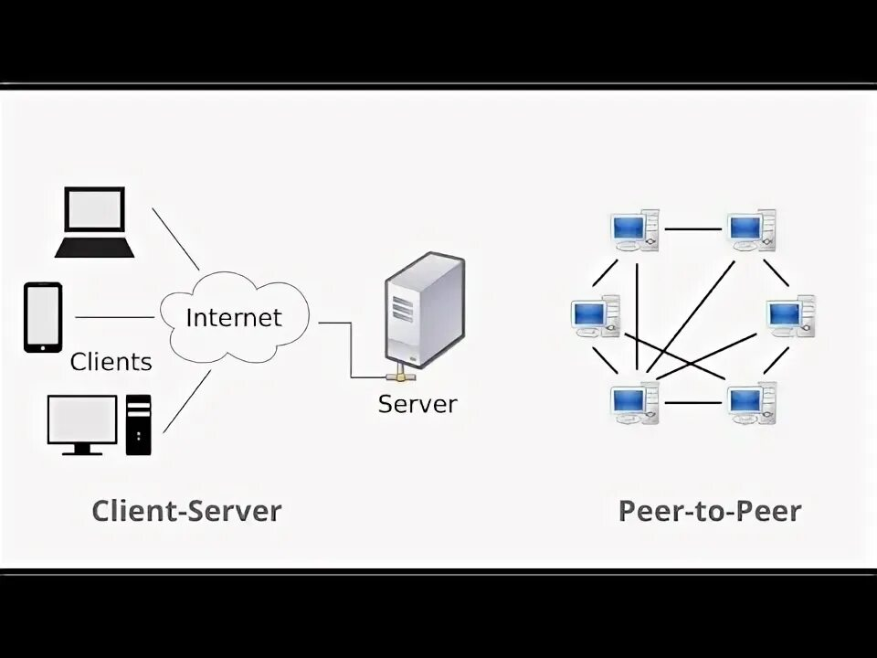
Overall Architecture
Hybrid Client-Server / P2P
The system follows a directory service model where the Central Server handles metadata, while binary data flows between clients.
Server (Port 5000): Handles client registry, peer discovery, and global directory.
Clients (Port 12346): Executes direct data exchange and hosts local file servers.

Slide 8




Network Protocols
TCP (Reliable)
UDP (Efficient)
Guaranteed delivery and error checking. Used for commands and critical file transfers.
Fast file uploads with lower overhead. Ideal for non-critical high-speed transmission.

Slide 9
Command Protocol Specification
Command | Direction | Functionality
REGISTER | Client → Server | Announce presence and P2P port to registry.
GET CLIENTS | Client → Server | Retrieve the current list of active online peers.
DIR | Client ↔ Server | List available files stored on the central repository.
RECEIVE FILE | Client → Client | Initiate the binary transfer sequence between peers.

Slide 10


System Implementation
Server Backend
Client Engine
Multi-threaded TCP handler processes all commands. UDP listener manages high-speed reception. ClientInfo objects track IP/Port metadata in a global registry.
Swing-based GUI for interaction. Integrated P2P server on port 12346. Automatic shared folder monitoring and chunk-based file writing logic.

Slide 11
User Interface Design
Connection page with auto-ID generation.
Server Files dashboard with download triggers.
Online Clients tab for peer browsing.
Real-time progress tracking for all tasks.

Slide 12
Edge Case Reliability
Robust Error Handling
100%
The system successfully manages server/client disconnections, missing file requests, and simultaneous concurrent transfers without UI blocking.
Implemented SwingUtilities.invokeLater() for thread-safe UI updates during high-intensity networking operations.
Data Integrity

Slide 13
Future Enhancements
Security
Resiliency
Efficiency
Auth
SSL/TLS encryption for all data.
Chunking and resumable downloads.
Bandwidth throttling and search.
User login and permission system.

Slide 14
Questions?
Thank you for your attention.
Addis Ababa Science and Technology University Distributed Systems Project 2024

